Slide 1


The Social Web
Lecture 3: Network analysis & research projects
Filip Ilievski and Davide Ceolin

Slide 2
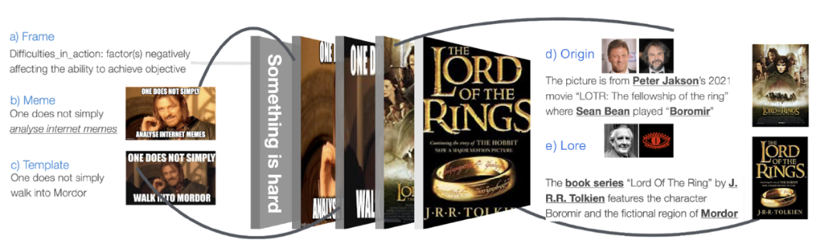
My passion: can AI make sense of complex media?
Factual knowledge
e.g., what recent events are being referenced?
Commonsense knowledge
e.g., why do we expect this community to care?
Related documents (intertextuality)
e.g., what news, social media posts fuel the virality of this post?
Metadata
e.g., in what context, like time, was this post made?
Social Web 2025, Filip Ilievski

Slide 3
Research projects

Slide 4
Research Project
Identify a relevant research question and:
position your work wrt literature and lectures;
(collect and) analyze Social Web datasets using adequate methods
explain how your project addresses the research question (evaluate!)
Submit
Python notebook with code & data
Research article
Present
project pitch
final presentation (12/12)
Social Web 2025, Filip Ilievski

Slide 5
Example Topics as Inspiration (from previous years)
trends over time & place in the online debate on hot topics:
COVID policies vs metrics, vaccinations in general
Climate change, immigration
gun policies in the USA, effect of school shootings;
analysis of social media discourse regarding product x, in correlation with marketing campaigns, newsworthy events, stock market fluctuations;
the impact of social media on voting campaigns in the USA and in the Netherlands; on Brexit, etc.
study of (new) ethical issues: clickbaiting, fake news, post-truth, echo chambers, censorship, surveillance, polarization, toxicity, propaganda, disinformation
Social Web 2025, Filip Ilievski

Slide 6
Course Rules
Project work in groups of max 4
Grades will be mostly (80%) group grades
Research paper: 50%
Notebook with code & data: 15%
Final (video) presentation: 5%
everybody contributes proportionally
consensus about who did what (required)
20% of the grade based on individual contribution
Every suspicion of fraud will be reported to the exam committee
Social Web 2025, Filip Ilievski

Slide 7
Introduction & Recap

Slide 8

SNS: Features
Personal proﬁles
Establishing online connections
Participating in online groups
Communicating with online connections
Sharing user generated content
Expressing opinions
Finding information
Retaining users
Social Web 2025, Davide Ceolin
Notes:
vary in the way they incorporate new information & communication tools:photo- & video-sharingbuilt-in blogging & instant messagingmobile-specific SNSs (e.g., Dodgeball) or support limited mobile interactions (e.g., Facebook, MySpace, and Cyworld)

Slide 9
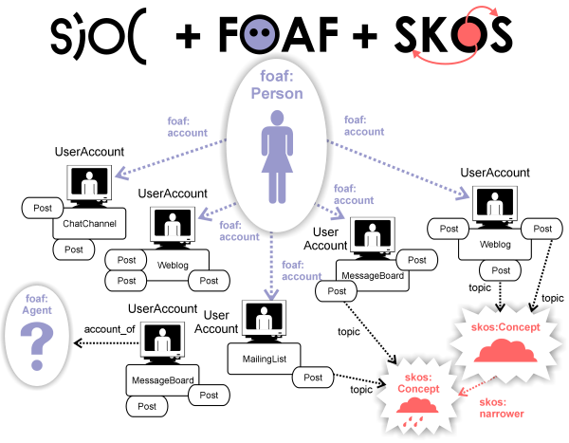
Social Web 2025, Davide Ceolin

Slide 10
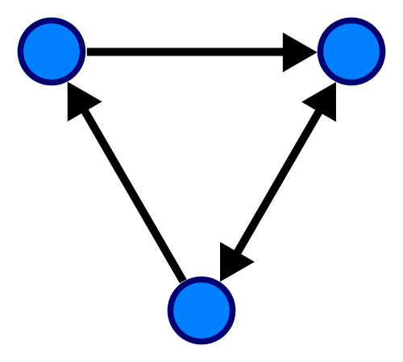
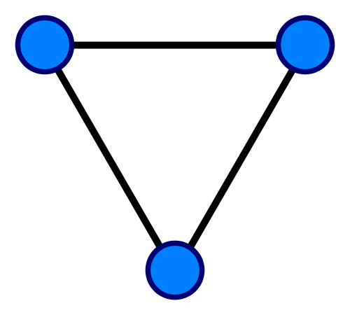
Types of graphs
Abstract graphs of unlabeled nodes and edges:
Directed Undirected
G = (V, E)
with V a set of vertices/nodes and E a set of edges/arrows
Social Web 2025, Davide Ceolin

Slide 11
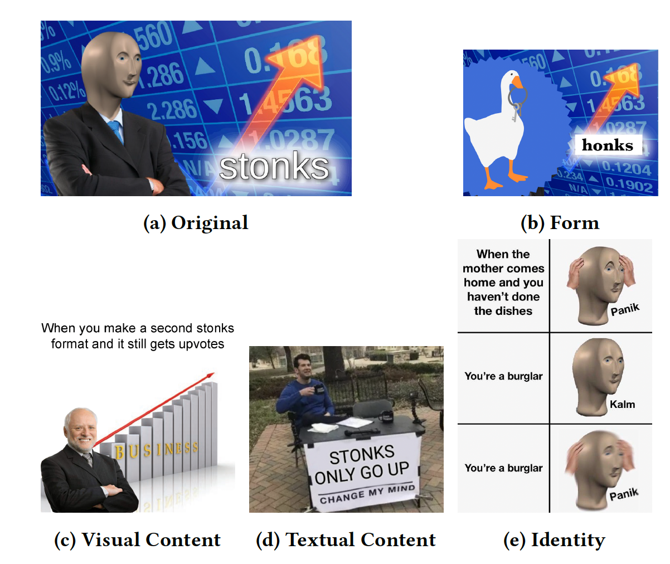
The Semantics of Sharing
On the Social Web, users “share”.
Sharing has multiple meanings:
An anecdote: text, picture, etc.
An opinion
As a review
As a rating
An experience: text, picture, video,
A remix/mashup: e.g., memes
The semantics of sharing is given by the semantics of the action (post, mention, etc.) + context.
Social Web 2025, Filip Ilievski

Slide 12
How would we derive value from all this data!?

Slide 13
Social Network Analysis

Slide 14
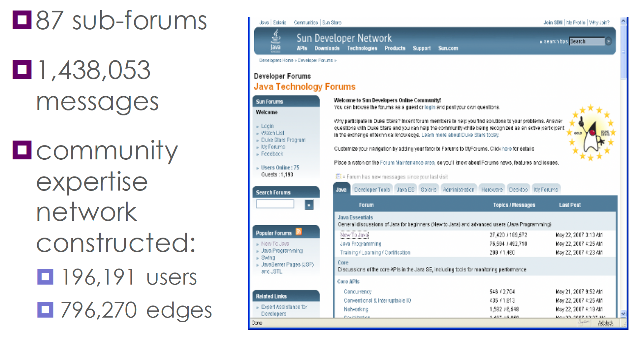
Java forum example

Slide 15
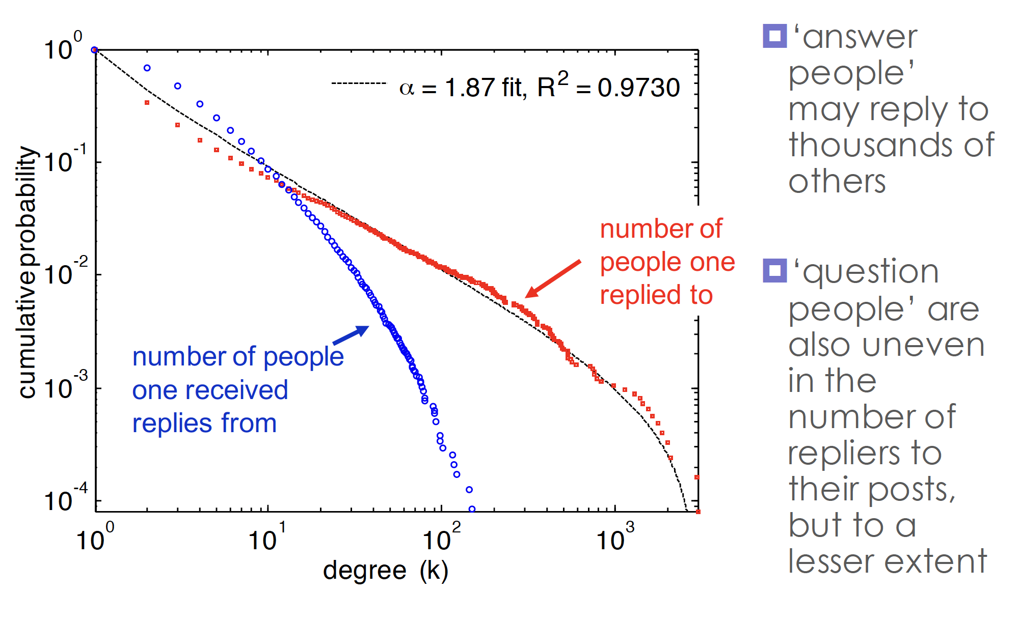
Uneven participation (‘long-tail’)

Slide 16
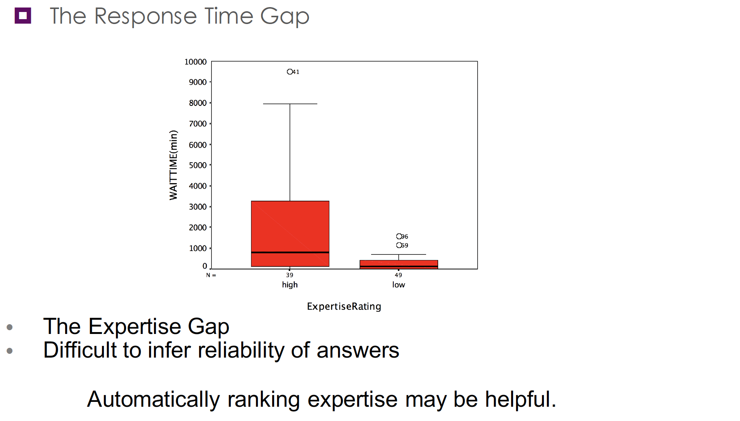
Why identify expertise?

Slide 17
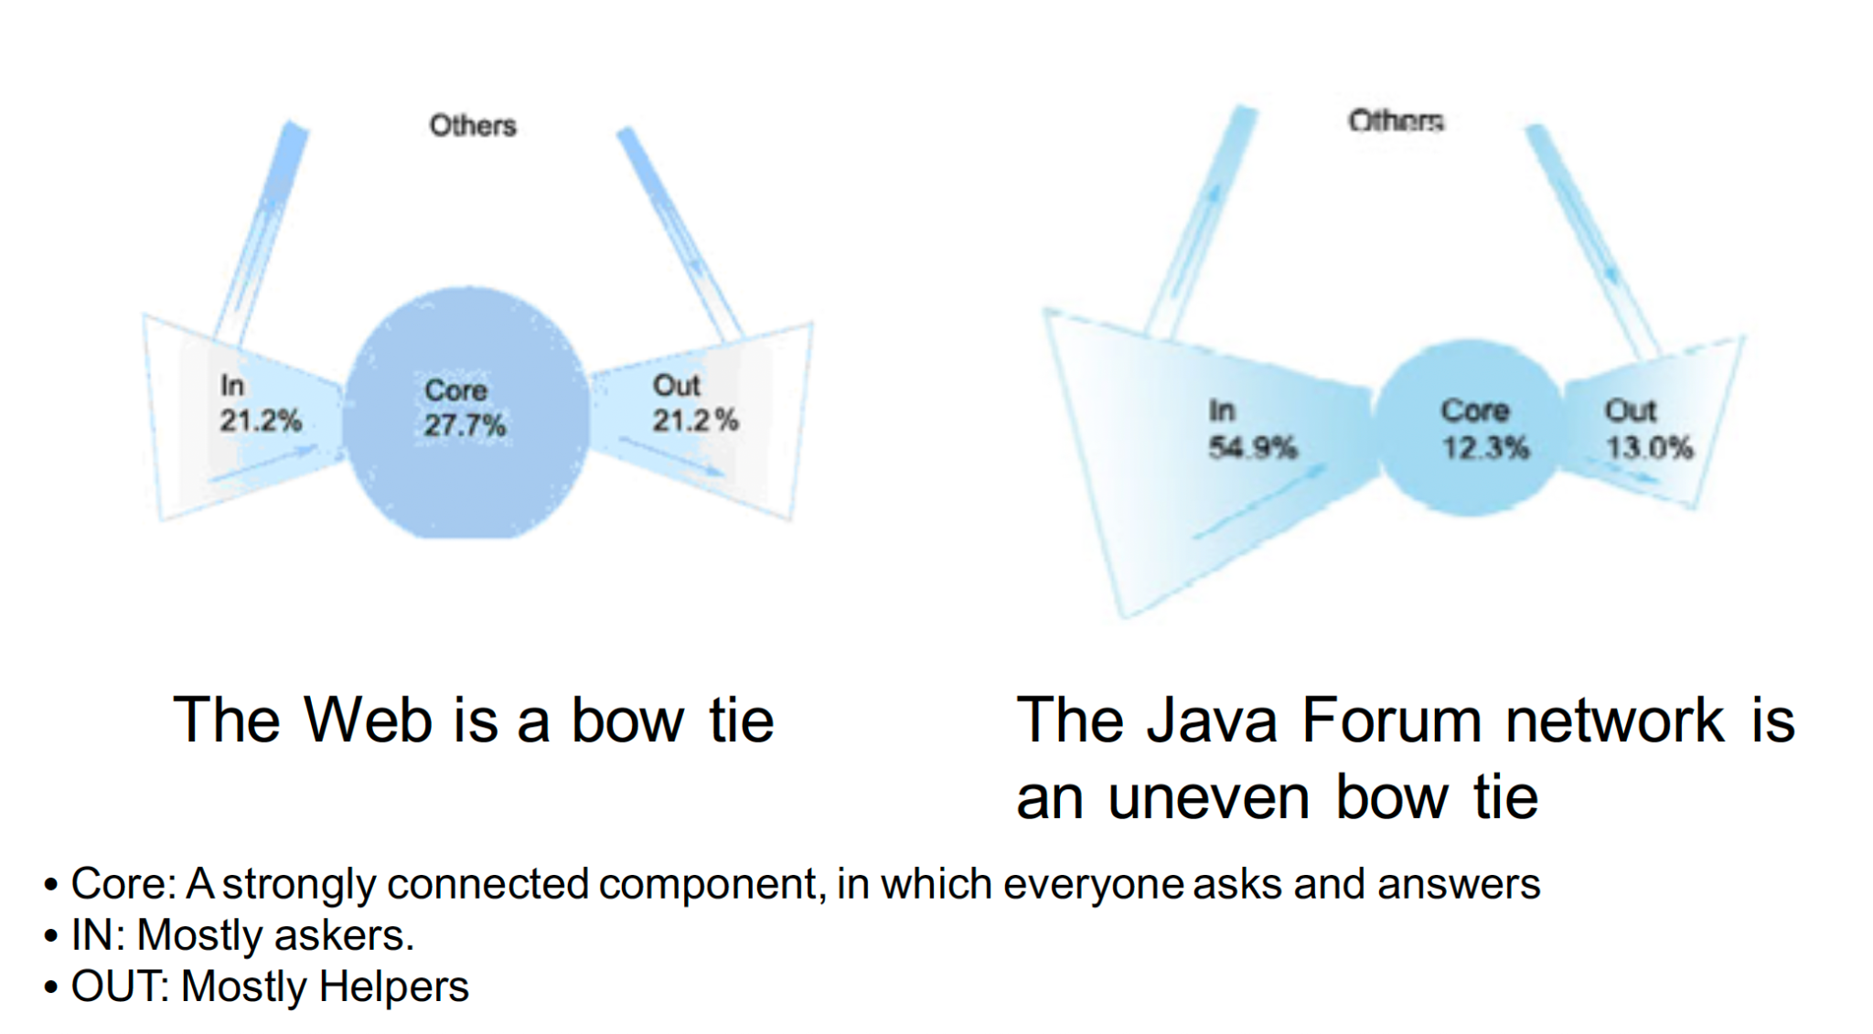
Not everyone asks/replies

Slide 18
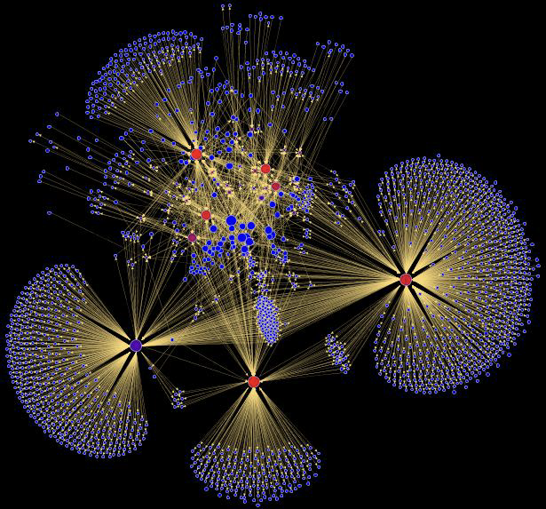
Fragment of the Java forum

Slide 19
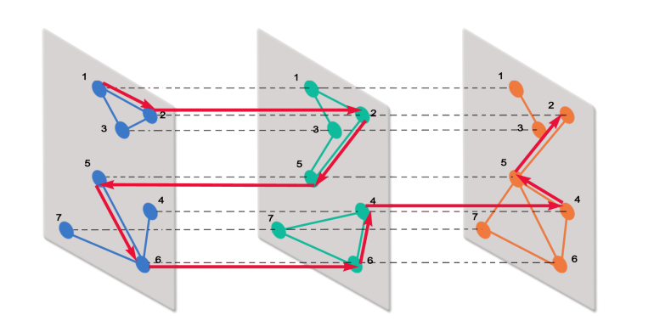
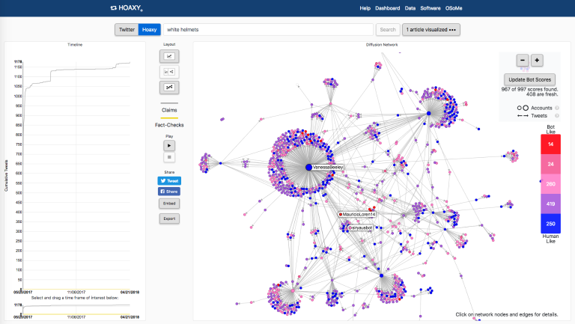
Why We Perform Social Network Analysis
To understand the network structure:
Who are the main actors/nodes/influencers?
Which groups/cliques are there?
How does it connect to relevant context (other networks, ongoing events)?
To understand how to better retrieve information.
How do we find reliable sources in large networks?
To understand virality:
e.g., to guide marketing campaigns.
To protect safety
Can it help in monitoring the spread of hoaxes and fake news?
Can it help us detect bots?
Social Web 2025, Filip Ilievski

Slide 20
Social Network Analysis: Responsible Use
Nodes often represent real people (sometimes accounts or posts)
Edges may represent actions (“likes”), relationships (“follows”), etc.
Avoid irresponsible research and writing
People are not mathematical objects
Properties of your model cannot be mapped 1-1 to properties of the real world
My online account ≇ me
A growing number of journals require social web research projects to obtain formal approval of an ethical review board.
Social Web 2025, Filip Ilievski

Slide 21
Social Network Analysis
Use of network theory to study social structures
Global properties of the overall network
density
# edges w.r.t. max. number of possible edges,
diameter
longest shortest path
...
Local properties
of an individual (“ego”) in the network
centrality (see notebook)
of local groups
motifs, communities, cliques (NP complete)
...

Slide 22
Social Network Analysis of Individuals: Centrality

Slide 23
Key insights from web page ranking
All nodes are not equally important
There is a large diversity in the network node connectivity
Trustworthy nodes may point to each other
Nodes that actually know about X (say newspapers)
might all be pointing to many instances of X (newspapers)

Slide 24
Basic concepts
Eccentricity: Maximum distance of a node to other nodes in the graph
Central point: node with lowest eccentricity
Radius: central point’s eccentricity (lowest max-distance)
Diameter: largest eccentricity (highest max-distance)
Social Web 2025, Filip Ilievski

Slide 25
Centrality metrics
Degree centrality
PageRank
HITS (hyperlink-induced topic search)
Betweenness centrality
Social Web 2025, Filip Ilievski

Slide 26
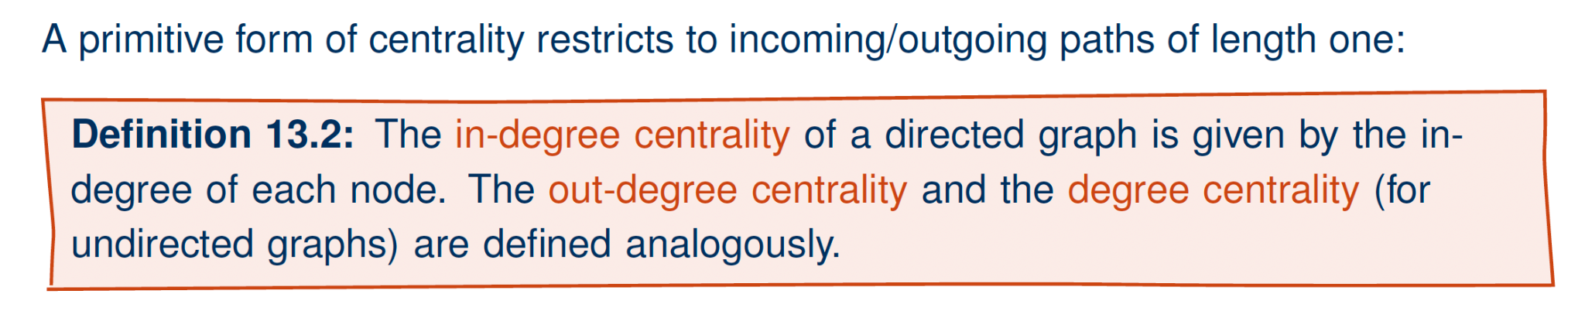
Degree centrality
Advantages:
easy to compute, easy to update, easy to understand
Disadvantages:
considers only direct neighbourhood, easy to manipulate
Social Web 2025, Filip Ilievski (adapted from M. Krotzsch)

Slide 27
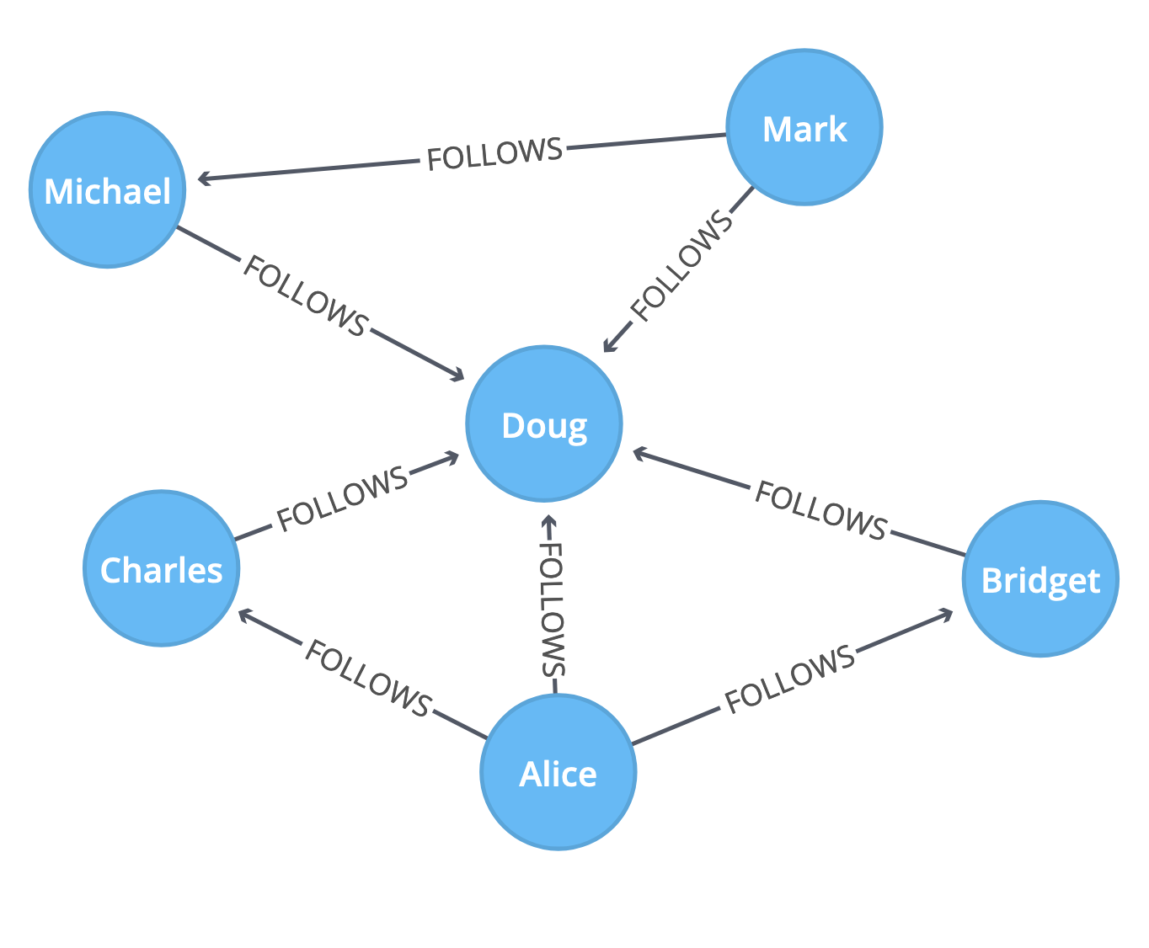
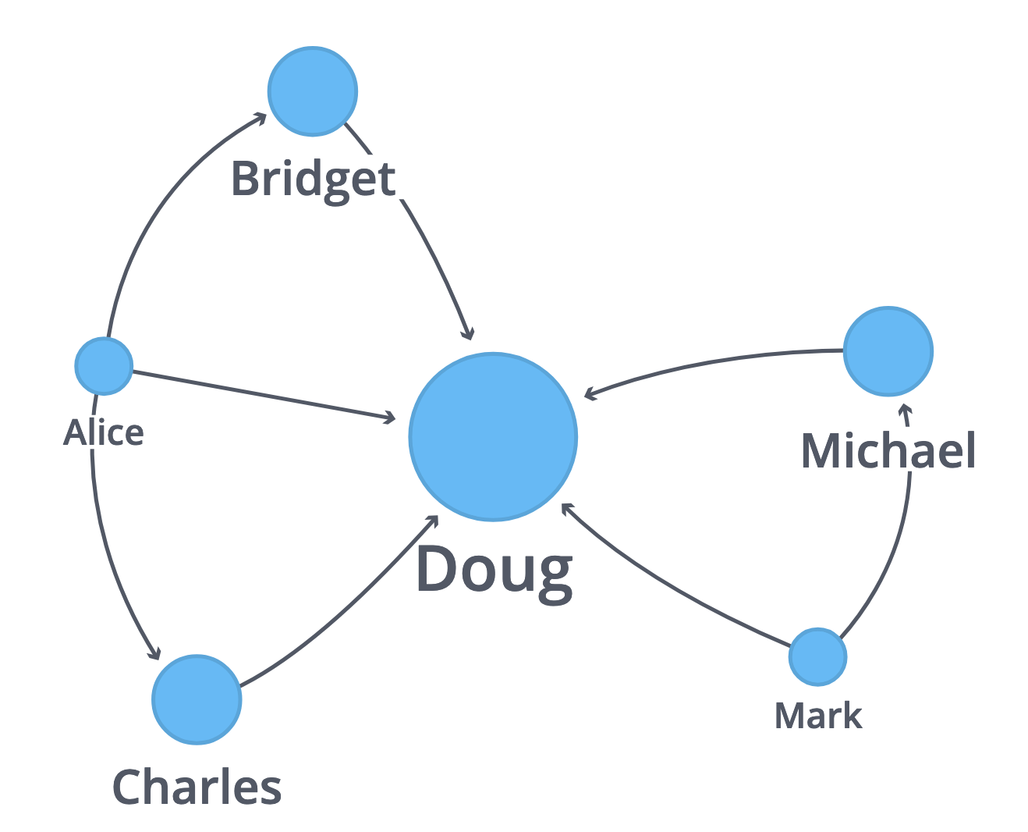
Degree centrality
Nodes with maximum in-degree or out-degree
Normalized by maximum degree
Social Web 2025, Filip Ilievski

Slide 28
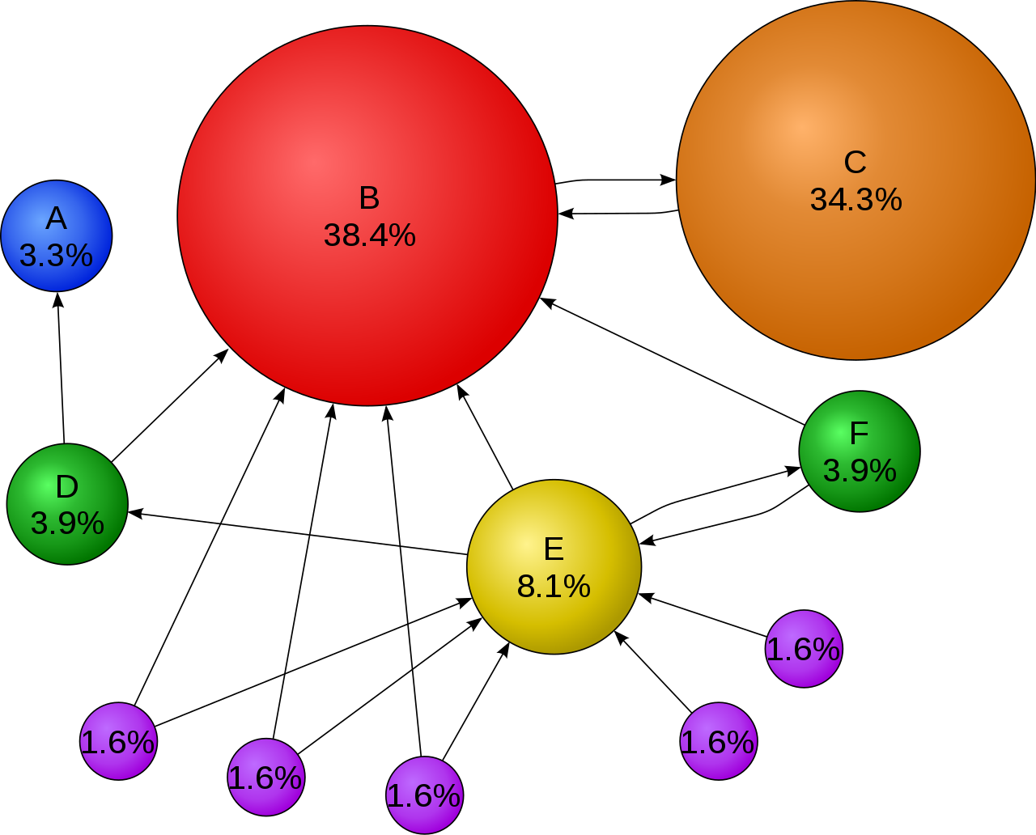
PageRank centrality
https://en.wikipedia.org/wiki/PageRank#/media/File:PageRanks-Example.svg
Web algorithm adapted for networks/graphs
Probability a random walk (with restart) will reach a node
A node importance is estimated through its votes (in-links)
Links from important pages count more
Iterative algorithm: each iteration distributes node’s PageRank to
neighbors
Social Web 2025, Filip Ilievski

Slide 29
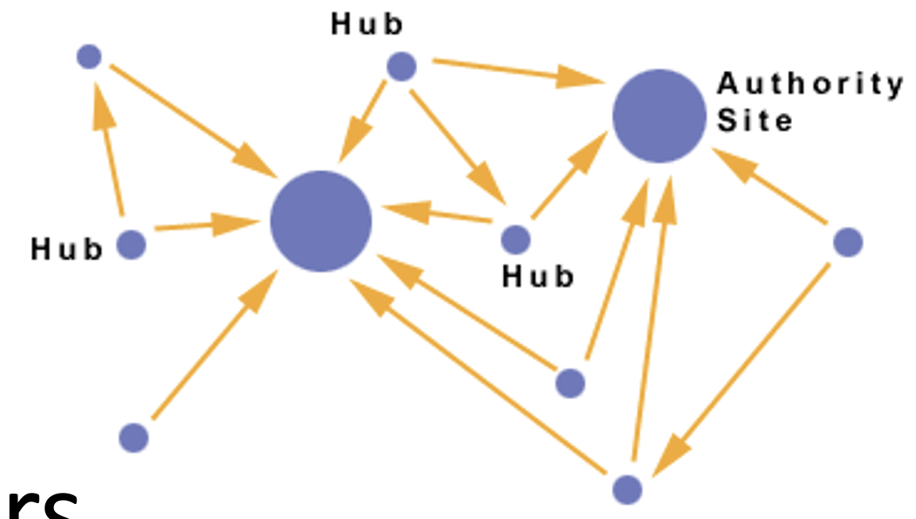
HITS centrality
https://www.eecs.yorku.ca/~papaggel/courses/eecs4414/docs/lectures/04-link-analysis.pdf
Distinguish between Hub and Authority nodes.
Authorities contain useful information, hubs link to authorities.
Each node has 2 scores: H and A
A good hub links to many good authorities
A good authority is linked from many good hubs
Note a self-reinforcing recursive definition
Iterate until convergence
Social Web 2025, Filip Ilievski

Slide 30
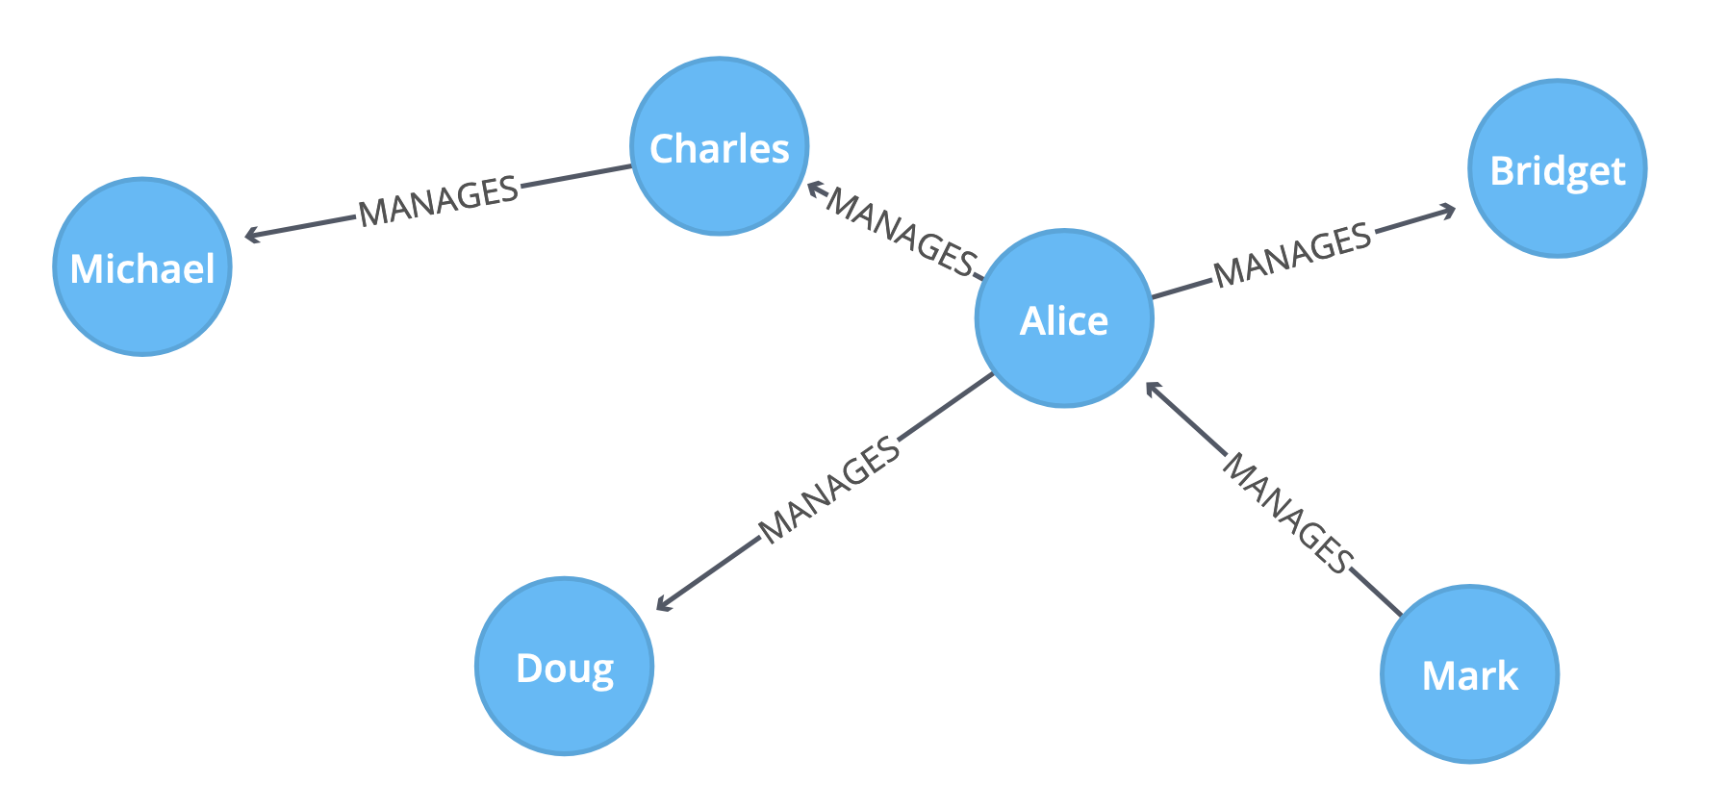
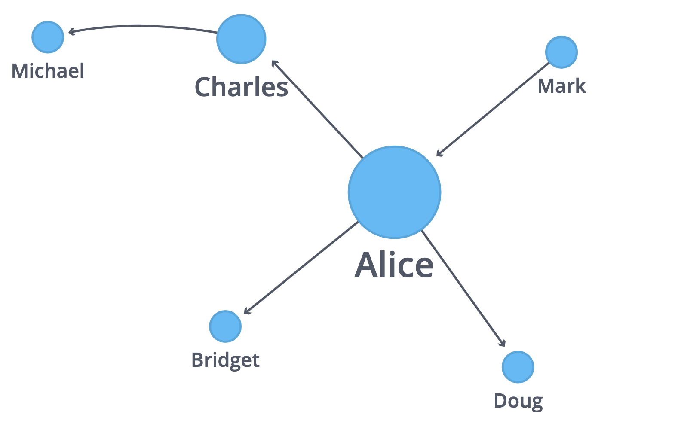
Betweenness centrality
Number of all-pairs shortest paths a node participates in
Social Web 2025, Filip Ilievski

Slide 31
Social Network Analysis of Groups: Community Detection
Social Web 2025, Filip Ilievski

Slide 32
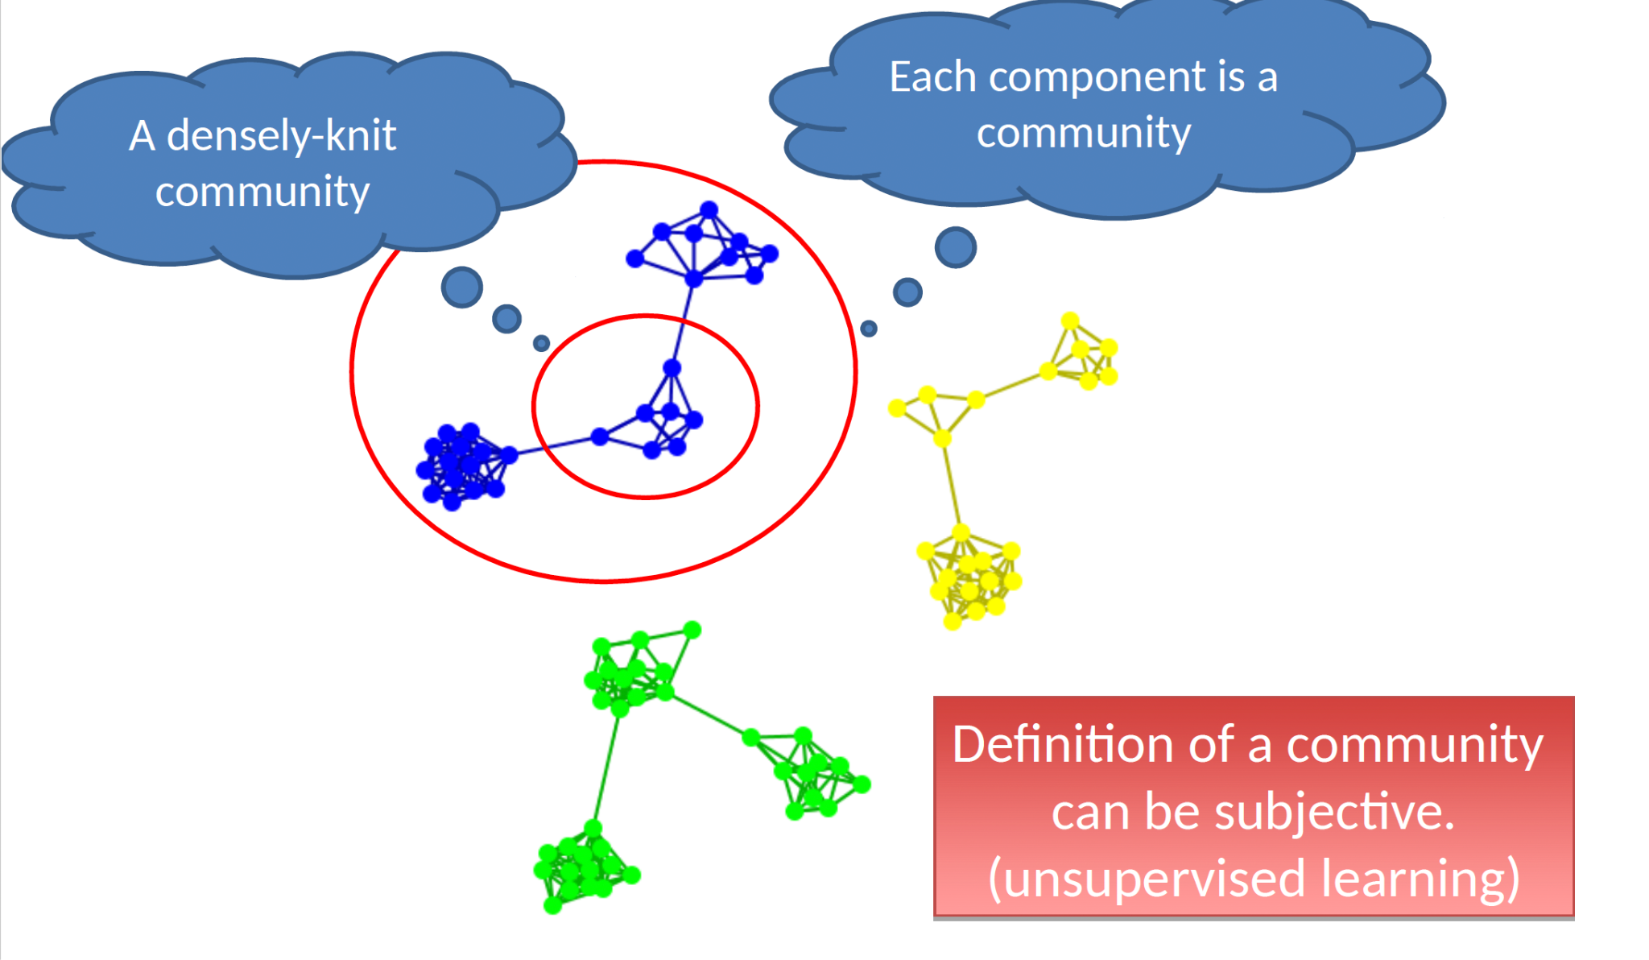
Community detection
Social Web 2025, Filip Ilievski

Slide 33
Taxonomy of community criteria
Roughly, community detection methods can be divided into
4 categories (not exclusive):
1. Node-Centric Community
– Each node in a group satisfies certain properties
2. Group-Centric Community
– Consider the connections within a group as a whole. The group has to satisfy certain properties without zooming into node-level
3. Network-Centric Community
– Partition the whole network into several disjoint sets
4. Hierarchy-Centric Community
– Construct a hierarchical structure of communities
Social Web 2025, Filip Ilievski

Slide 34
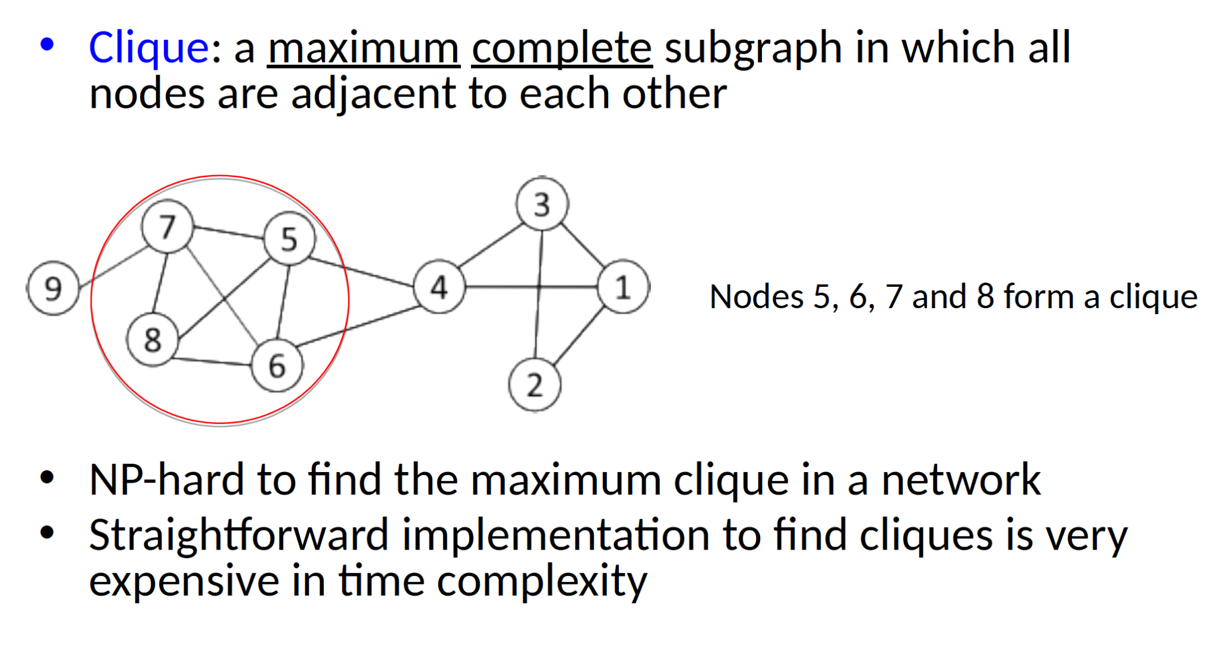
Complete mutuality: Cliques
Social Web 2025, Filip Ilievski

Slide 35
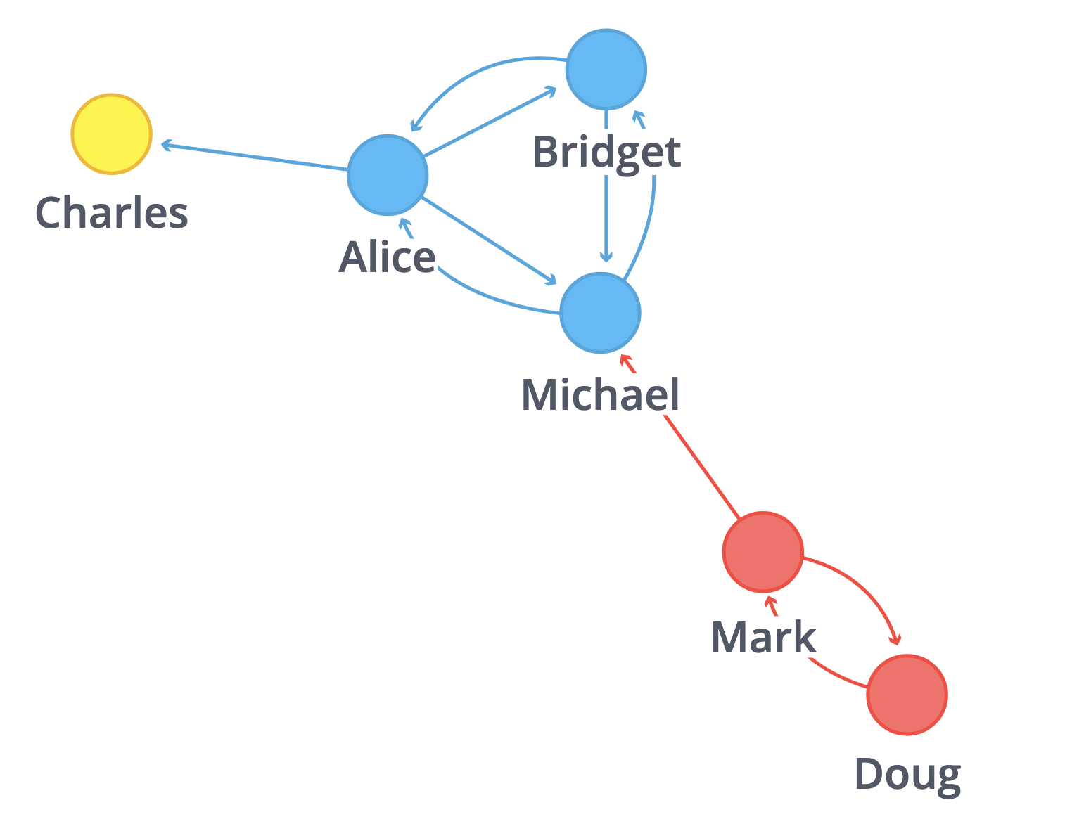
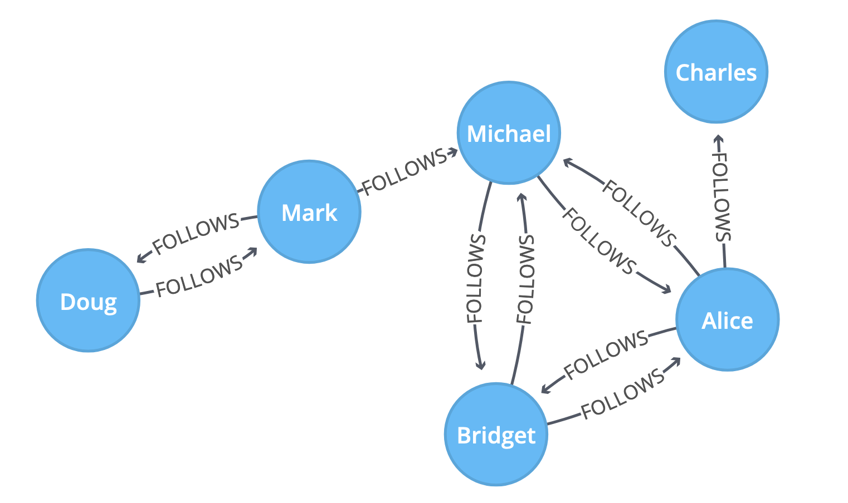
Connected components
Set of nodes where each node is reachable from all other nodes
Social Web 2025, Filip Ilievski

Slide 36
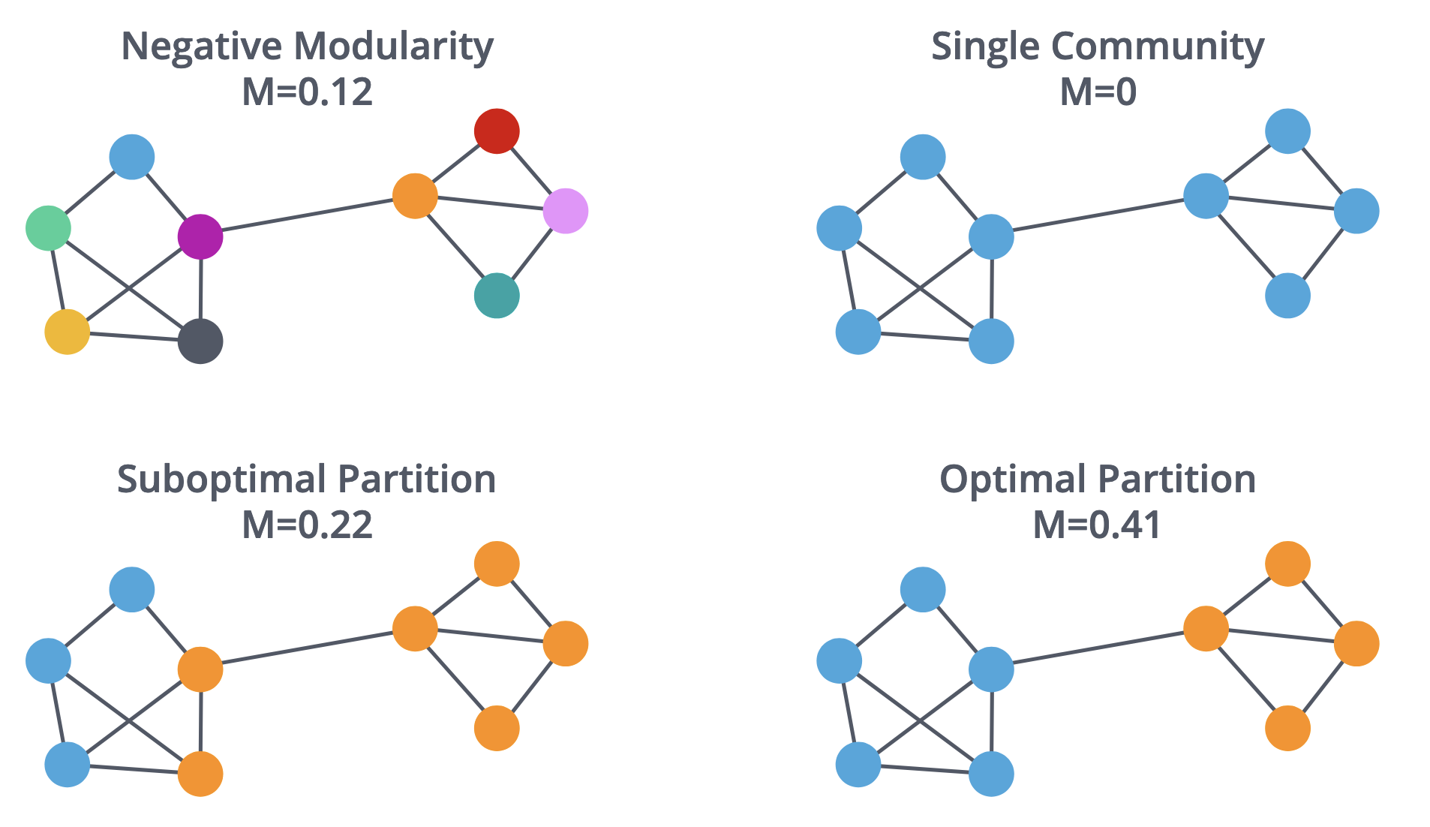
Modularity
Number of within-cluster edges minus expected edges in random graph
Social Web 2025, Filip Ilievski

Slide 37
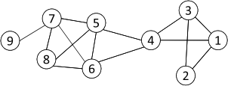
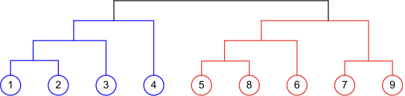
Agglomerative Hierarchical Clustering
Initialize each node as a community
Merge communities successively into larger communities following a certain criterion (e.g., based on modularity increase)
Social Web 2025, Filip Ilievski

Slide 38
Social Network Analysis of Internet Memes

Slide 39
Why We Study Memes?
Cultural artifacts encapsulating modern folklore.
They reflect the social landscape.
Possible sources of threats and issues.
#10yearschallenge
Satire is often linked to post-truth.
Vehicles for virality.
Insights into psychology, social network analysis, technology diffusion and utilisation.
Media study analysis.
Users are increasingly active.
Tool criticism.
Social Web 2025, Davide Ceolin

Slide 40
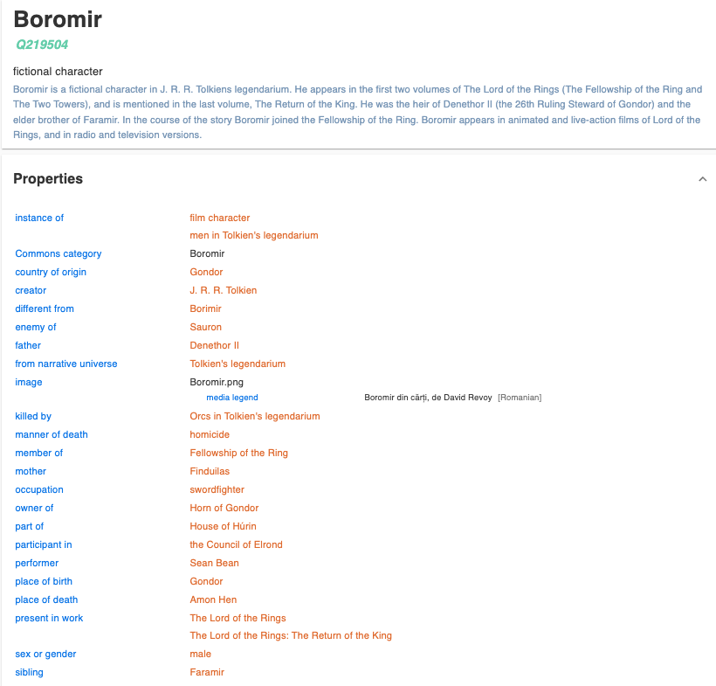
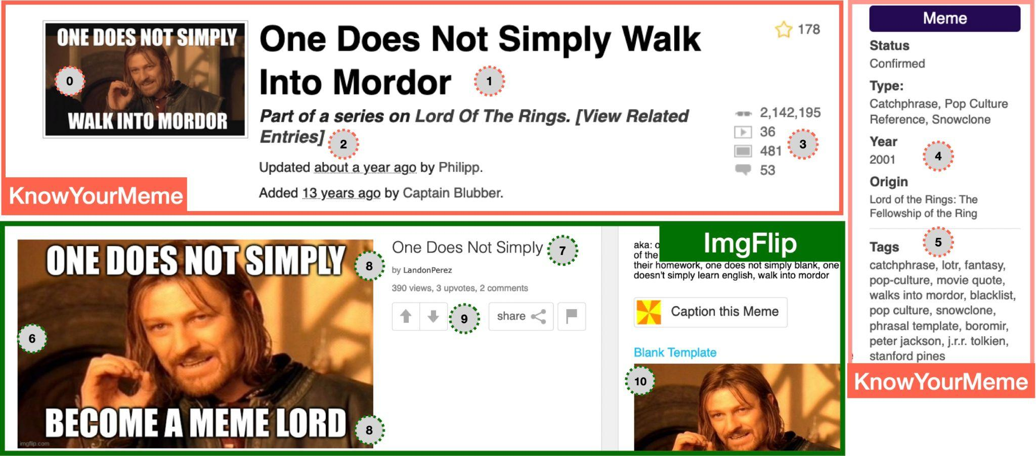
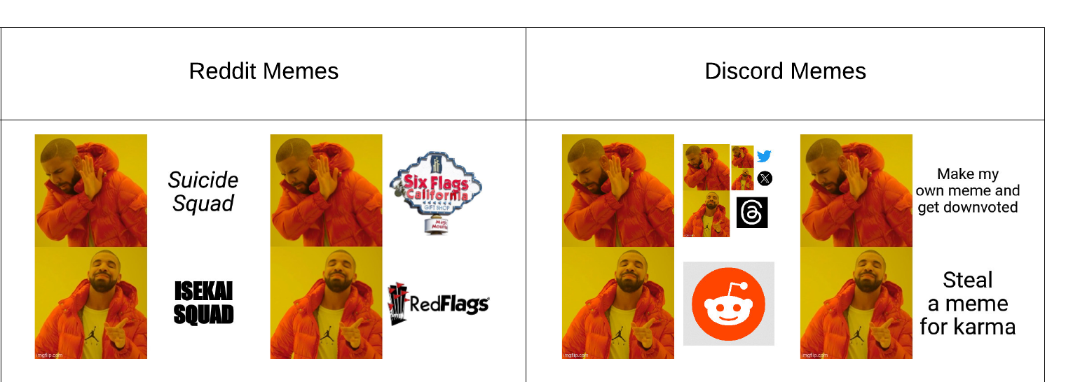
Where are Memes Found?
Meme encyclopedias and generators
Extra knowledge in Wikidata
Social media sites
Social Web 2025, Filip Ilievski

Slide 41
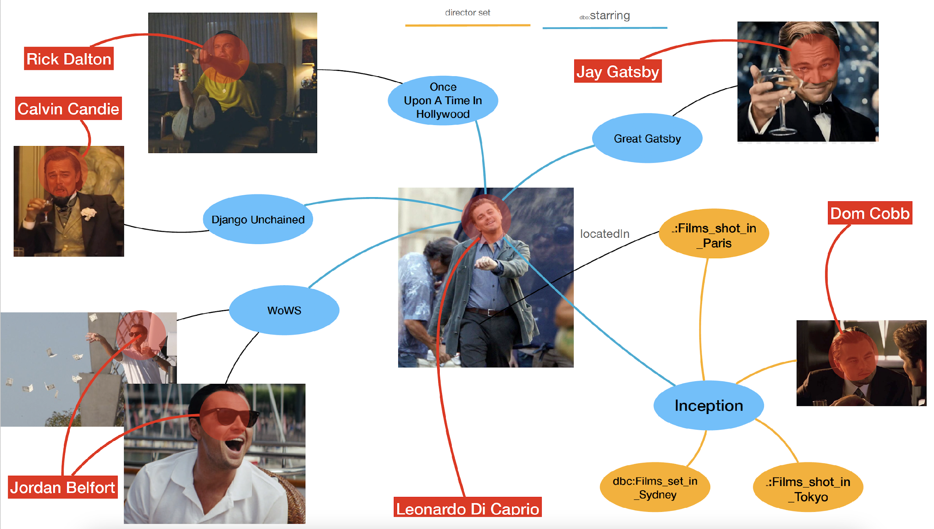
Consolidating internet meme information: The Internet Meme Knowledge Graph (IMKG)
IMKG: The Internet Meme Knowledge Graph. R Tommasini, F Ilievski, T Wijesiriwardene. ESWC 2023
Social Web 2025, Filip Ilievski (figure by Riccardo Tommasini, 2023)

Slide 42






Most central nodes in IMKG
PageRank
HITS authorities
USA
kym:lolcats
kym:x-shuts-up-the-queen-of-hearts
English
kym:nice-meme
human
Social Web 2025, Filip Ilievski

Slide 43



Analytics: Most Memeable People ?
Social Web 2025, Filip Ilievski

Slide 44




Analytics: Memes Based on Films?
Memes
Films
Social Web 2025, Filip Ilievski

Slide 45

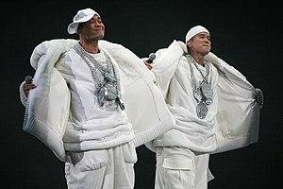

Analytics: Entities Common in Meme Captions
bling-bling
Kermit the Frog
Batman
Social Web 2025, Filip Ilievski

Slide 46
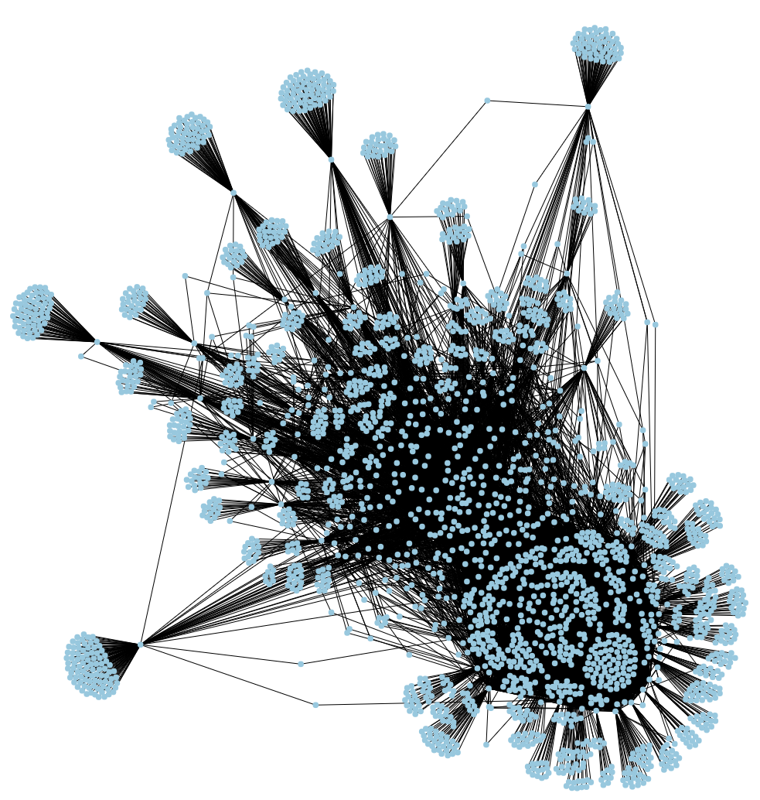
IMKG Analytics: Connections of Memes with Sponge Bob Square Pants
Social Web 2025, Filip Ilievski

Slide 47
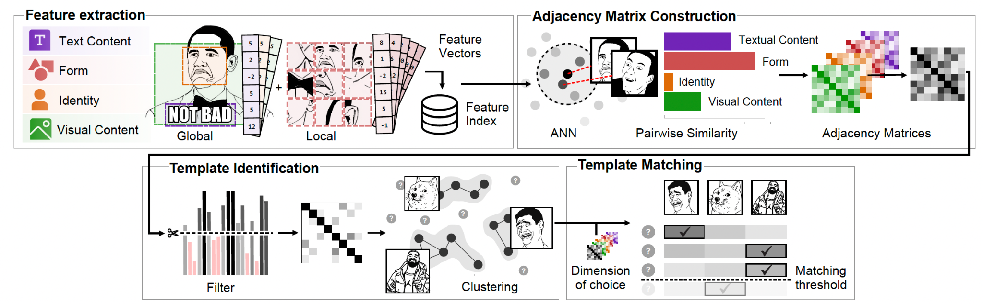
Clustering memes based on their content
Bloem, T. & Ilievski, F. (2025). Clustering Internet Memes Through Template Matching and Multi-Dimensional Similarity. ICWSM.
Social Web 2025, Filip Ilievski

Slide 48
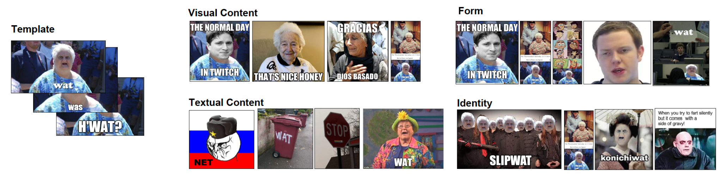
Clustering memes based on their content
Bloem, T. & Ilievski, F. (2025). Clustering Internet Memes Through Template Matching and Multi-Dimensional Similarity. ICWSM.
Social Web 2025, Filip Ilievski

Slide 49
Concluding remarks
Network analysis methods are important to gain insights into the structural properties of a network
Centrality metrics (HITS, PageRank, betweenness) capture node importance
Community detection methods (cliques, modularity) capture informative groups in the network
Network analysis is broadly applicable in terms of formats (forums, memes, SM posts) and phenomena (misinformation, hate speech, virality)
In practice it makes sense to combine with content analysis (sentiment, entity detection, visual features, …)
Social Web 2025, Filip Ilievski

